Slide 1
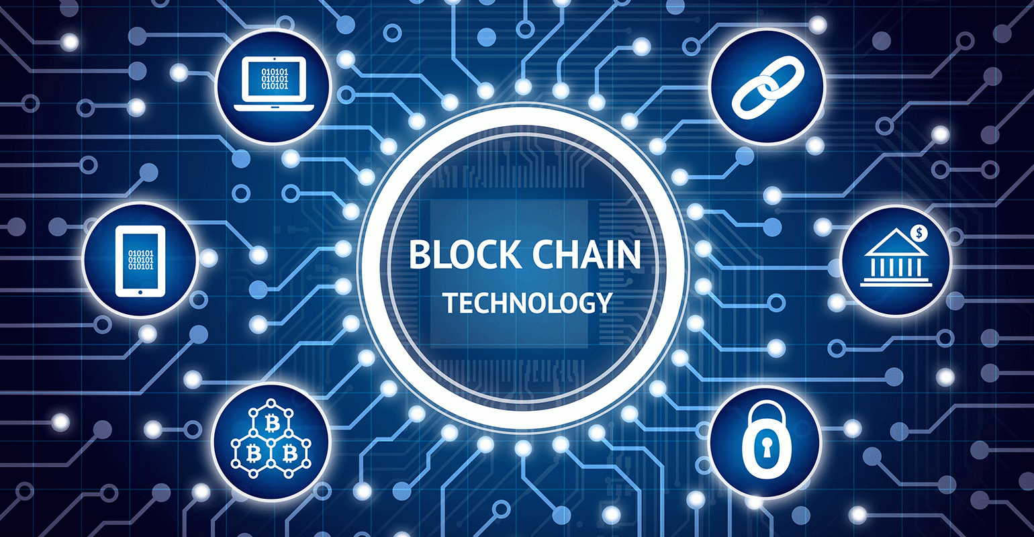
Blockchain in Healthcare
Group 6
Aman Sharma-19126
Manguirish Gaunekar-19138
Monica P M-19150
Riddhi Patsa-19162
Suhas M S-19174

Slide 2
Introduction to Blockchain
A blockchain is an open record of all cryptographic transactions that have ever been executed.
The blocks are added to the blockchain in a linear, sequential order.
The blockchain has complete information about the addresses and their balances right from the beginning piece to the most as of late finished block.
It keeps track of each and every transaction performed, adding and appending each to form a chain of information on transaction, usage and distribution.

Slide 3
Why Blockchain?
Decentralized and shared control.
Peer to peer.
Cryptographically Secured.
Add only.
Consensus.

Slide 4
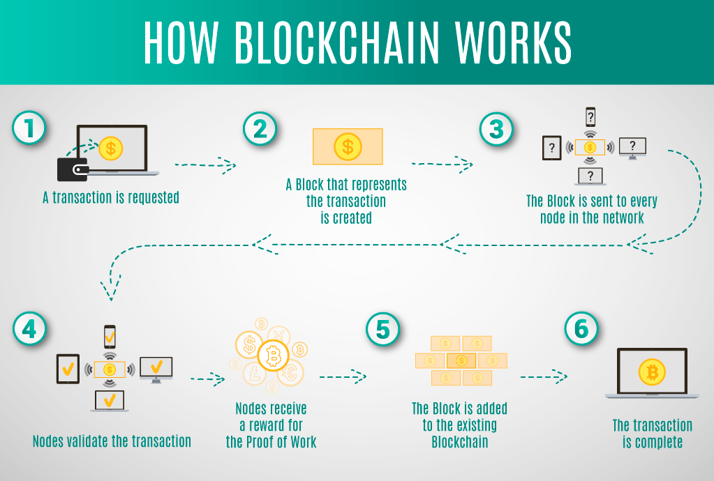
How Blockchain works?

Slide 5
Advantage
Transparency
Reduced transaction costs
Faster transaction settlements
Decentralization
User-controlled networks

Slide 6
Uses of Blockchain in Health Care
Blockchain has the potential to substantially impact the health care industry as a whole and payers, providers and patients with respect to drug traceability, clinical trials and research, and data management.

Slide 7
Drug Traceability
Counterfeiting is a major problem for the pharmaceutical industry.
10 to 30% of drugs sold in developing countries are counterfeit .
The market exceeds $200 B annually.
China and India are the major manufacturers.
Ingredient and dosages are impacted – which may cause adverse reactions or not provide the expected treatment.

Slide 8
Continue..
Manufacturer marks with a unique code.
Hash is produced for the drug (contains all relevant information).
The drug information is stored on the blockchain. Each time the drug is moved in the process, that information is stored on the blockchain – wholesaler verifies and sends to pharmacist, pharmacist delivers to the patent.

Slide 9
Clinical Trials
Mistakes or fraud may occur.
Considerable amounts of data are produced from the trials themselves including safety, efficiency and quality data.
Many people will “touch” this data.
Data collection may not be standardized.

Slide 10
Continue
Provides proof of existence for and verification of trial data and transparency.
Would include the trial protocol, results, site information, required consents, etc.
Allows reproducibility and secure data sharing among research communities.

Slide 11
Patient Data Management
Managing patient data requires complete access the individual medical records to be shared among various clinicians and other professionals and to and from various locations.
No standards for collection, storage or disclosure of such information.
Social networks and physician portals are not always secure.
Patients do not control their data.

Slide 12
Continue..
Information can be stored in smart contracts containing permissions and conditions for release.
Patients control access – private keys unlock access or third parties authorized by the patients can do so.
Blockchain could also collect information from web-based and mobile applications or other devices and becomes very important for digital health.
Development and other costs, concern of patients, scalability, storage limits and capacity are obstacles to be addressed

Slide 13
Limitations.
Complexity
Transaction costs -each transaction costs about $0.20 and can only store 80 bytes of data.
Human error - garbage in, garbage out.
Unavoidable security flaw - 51% attack.

Slide 14
Conclusion
The most efficient and effective approach for advanced health IT based.
A shared distributed infrastructure that provides a comprehensive view of an individual’s health data across a lifetime is an equally essential component of interoperable health IT systems.
Utilization of the proposed health blockchain has the potential to engage millions of individuals, health care providers, health care entities and medical researchers to share vast amounts of genetic, diet, lifestyle, environmental and health data with guaranteed security and privacy protection.

Slide 15







